Slide 1
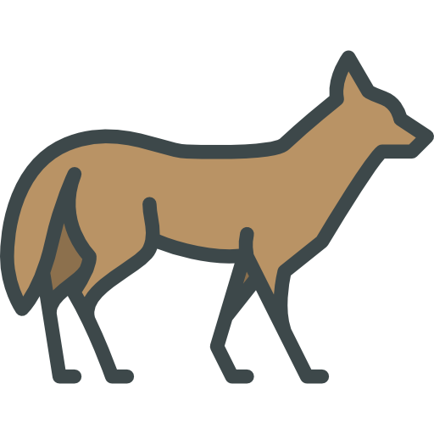
Midterm Presentation
Team Coyote1
2022 KSW Fall Program

Slide 2
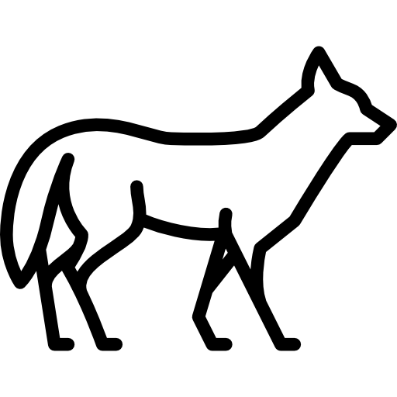
01. Introduction
02. Progress
CONTENTS
03. Problem
04. Weekly Plan

Slide 3
Introduction
01
Introduction

Slide 4
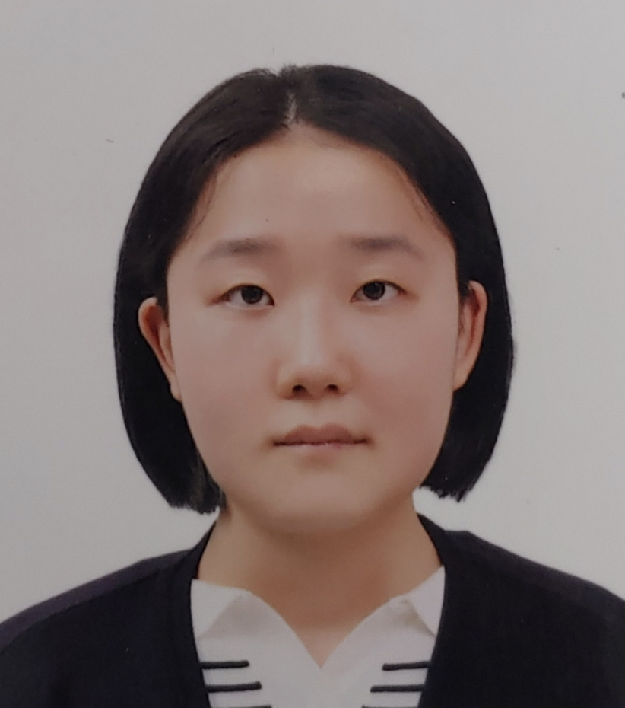

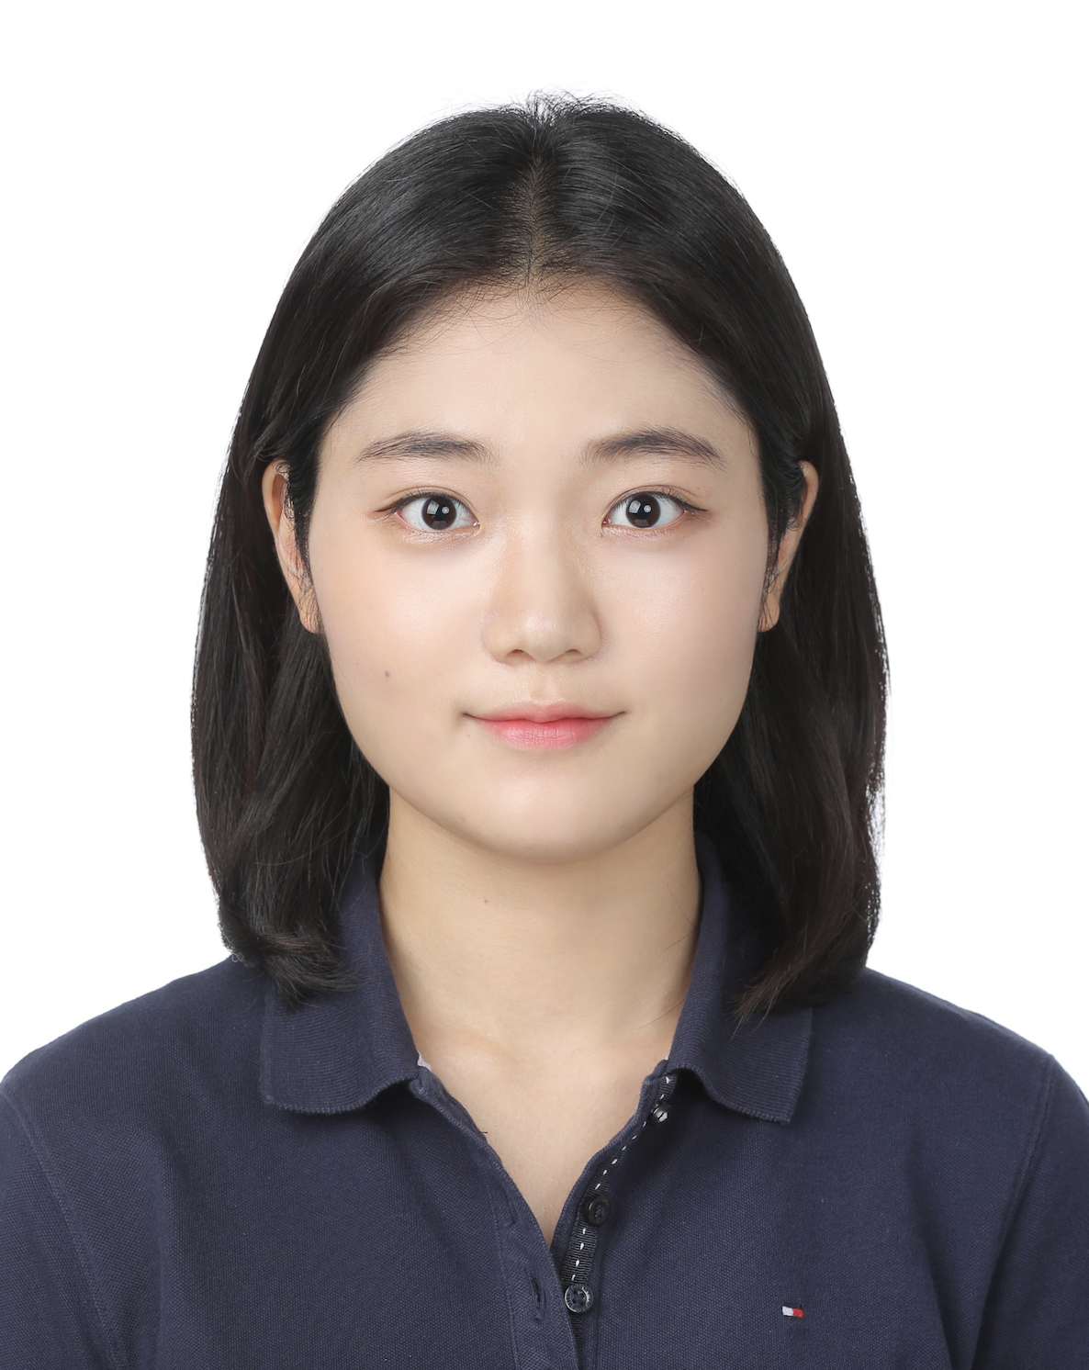
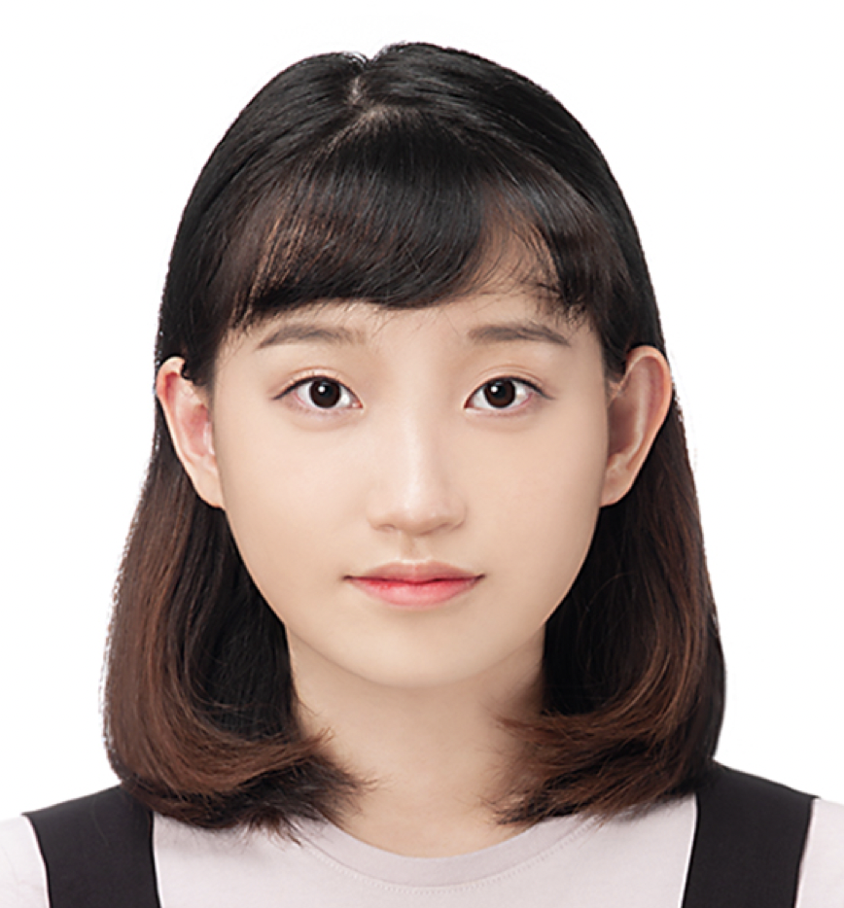
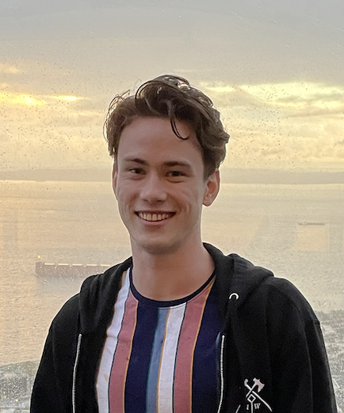
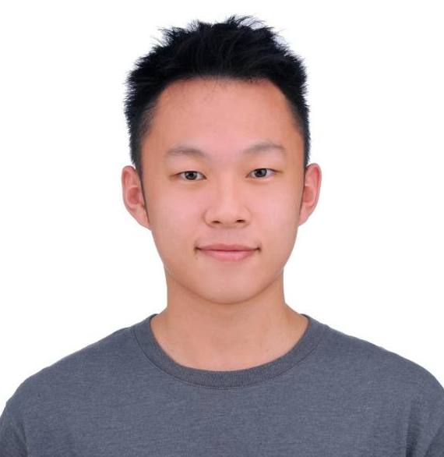

1.1 Team members
Hyemin Lim
Chung-Ang University
Computer Science and Engineering
Hyeongjun Kim
Daegu Catholic University
Computer Engineering
Jaehui Boo
Dankook University
Computer Engineering
Nayoun Kim
Woosong University
Information Technology Convergence
Justin Anderson
Purdue University
Network Engineering Technology
Wei-Chieh Chin(Victor)
Purdue University
Computer & Information Technology

Slide 5

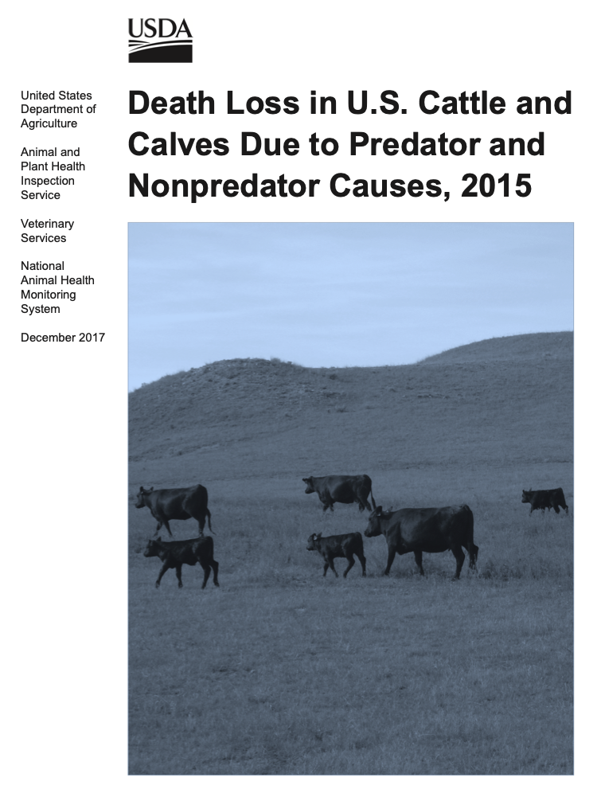

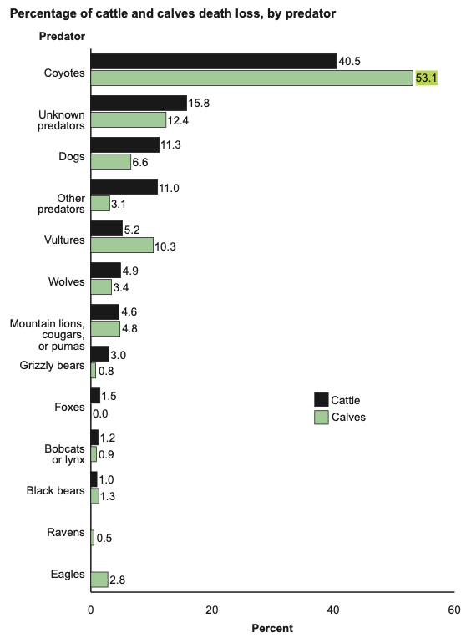



1.2 Background
Cost-Effective
Easy-to-use

Slide 6
1.3 Project Architecture
The Things Stack
Acoustic
Sensor
Machine Learning /
Deep Learning
Sensor
Network
NodeMCU
LoRaWAN
Acoustic
Sensor
Raspberrypi
LTE/Wifi
Application
Server
Gateway
MQTT
NodeMCU
Machine Learning /
Deep Learning
Visualize
Acoustic
Sensor
Ethernet / Wifi / Cellular
NodeMCU
Cam

Slide 7
Progress
01
02
Progress

Slide 8
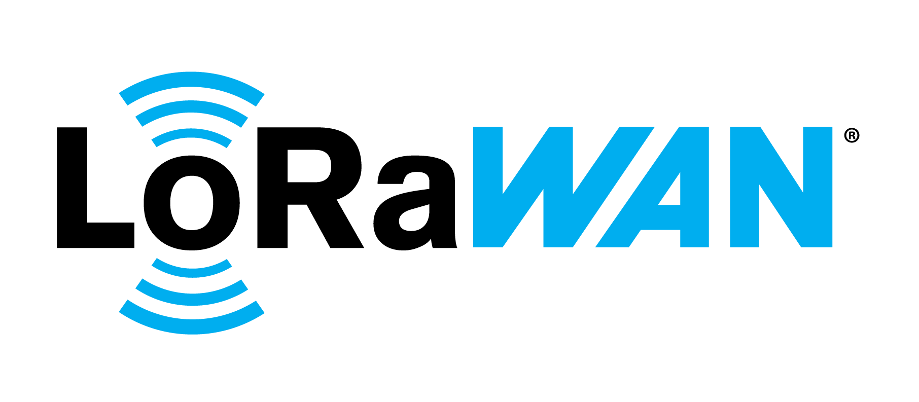

2.1 LoRaWAN
Network server stack
Open-source components for networks
Physical layer process of radio modulation

Slide 9



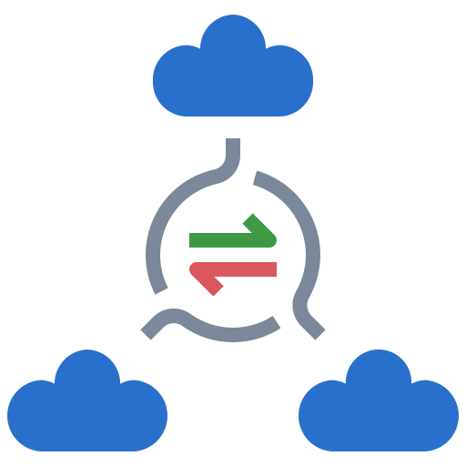


2.1 LoRaWAN
Low Power Consumption
Years of Battery Life
Long-distance
Multi-usable
Scalable
Cost-effective

Slide 10



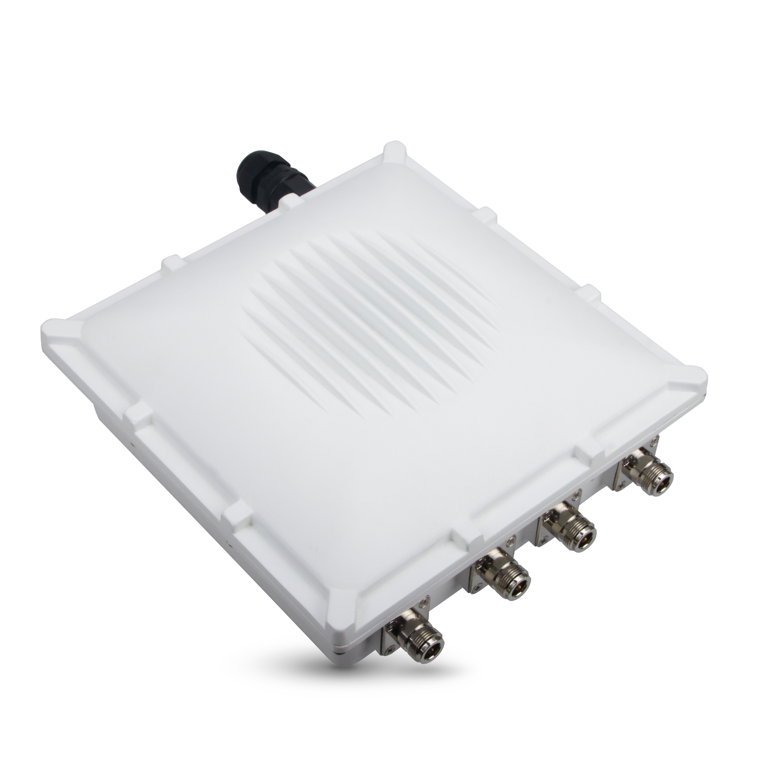
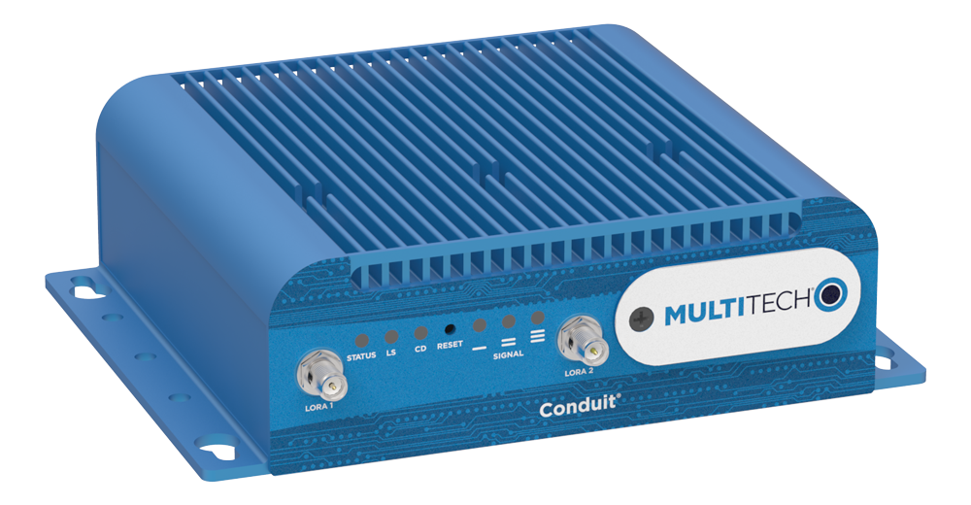

2.2 Gateway
To connect the gateway to the ResIoT,
The program provided by the ResIoT had to be installed on the gateway.
Memory error that the multi-tech gateway lacked storage
When we looked at how much storage was left
on the mLinux terminal, there was enough storage
ResIoT did not support the Rak gateway
Multi-tech gateway
Rak7249 Gateway

Slide 11

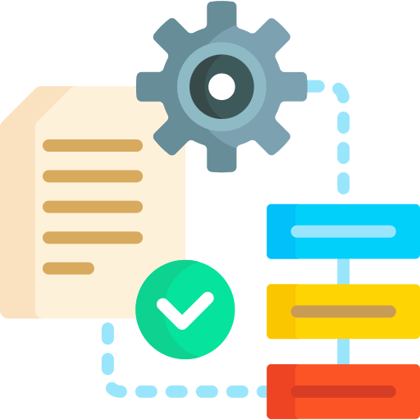

2.2 Gateway
Local Server VS Cloud Server
Failed to install it due to unknown errors
configuration files
The application server could be created
Connection failed due to an authentication problem
uploaded

Slide 12


2.2 Gateway
The process of building the server went smoothly
If clients are connected to the same network, we can access to the application server through the static IP address
It was necessary to access the console window to register the gateway,
but it was not possible to access the console window
Re-created the certificate and tried registering
The same authentication problem occurred such as 401 and 404 errors
multi-tech gateway
had been previously registered.

Slide 13


2.2 Gateway
Decided to turn our attention back to the cloud server.
An attempt was made to register a different multi-tech gateway
with the SENET cloud server.
The multi-tech gateway could not connect to the Internet,
so the gateway software provided by SENET could not be installed.

Slide 14


2.2 Gateway
Tried to connect the RAK7249 gateway to The Things stack
But it always show disconnected
Debugged the Rak’s Internet connection
Connected to The Things Network again,
the gateway’s status said connected-!!

Slide 15



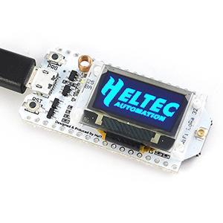
2.3 Esp32 – Gateway
[Esp32]
Wifi & Bluetooth
Low-cost &
Low-power
Temperature range
Wide Range of applications can be targeted
Low-cost & Low-power system on a chip microcontrollers
Wide operating temperature
(-104℉ ~ 221℉)

Slide 16
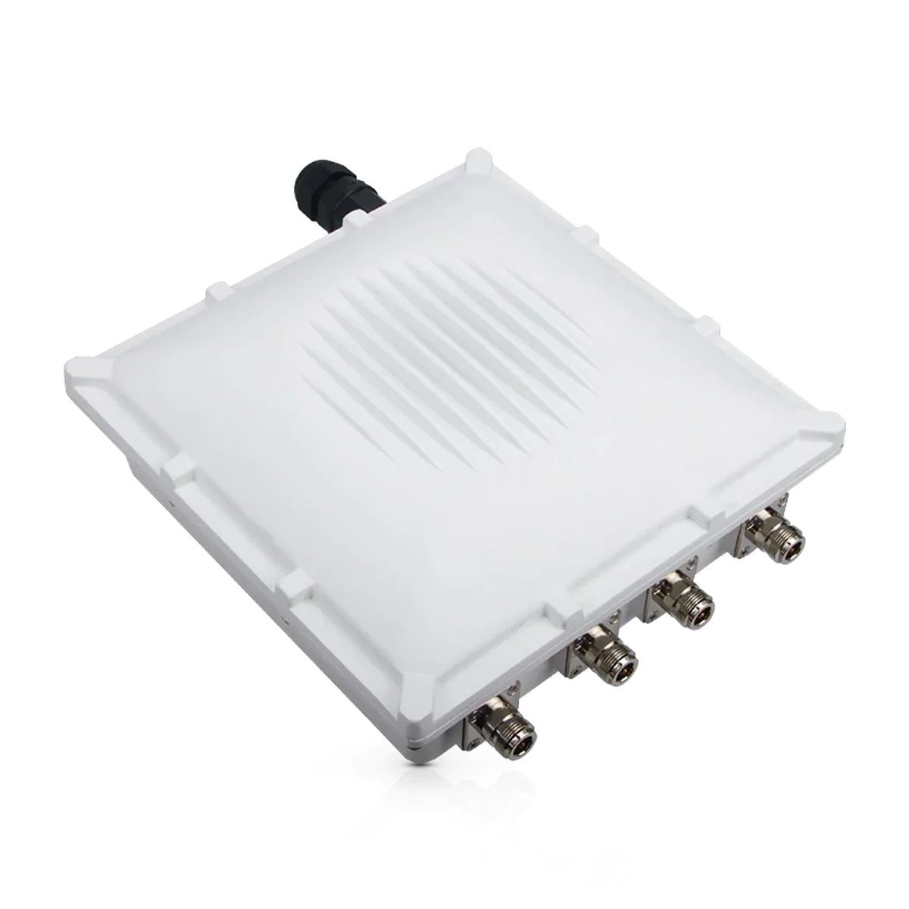
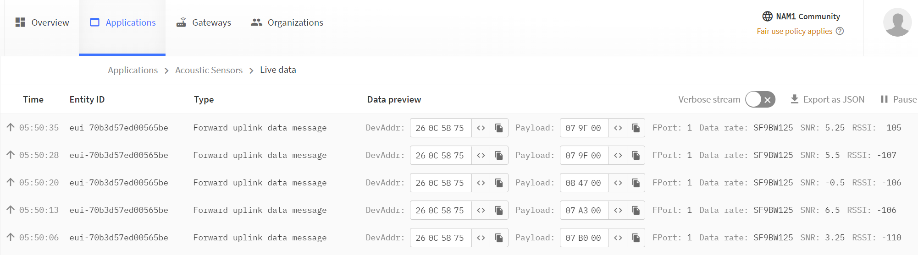
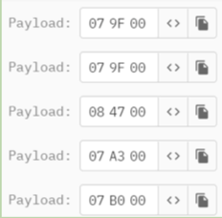
2.3 Esp32 – Gateway
[Esp32]

Slide 17


2.4 Gateway – Raspberry pi
[MQTT]
Message Queuing Telemetry Transport
Light weight Machine - Machine
Minimum power & packet
Publisher
MQTT Broker
(Mosquitto)
Subscriber
Connect
Publish
Connect
Subscribe

Slide 18
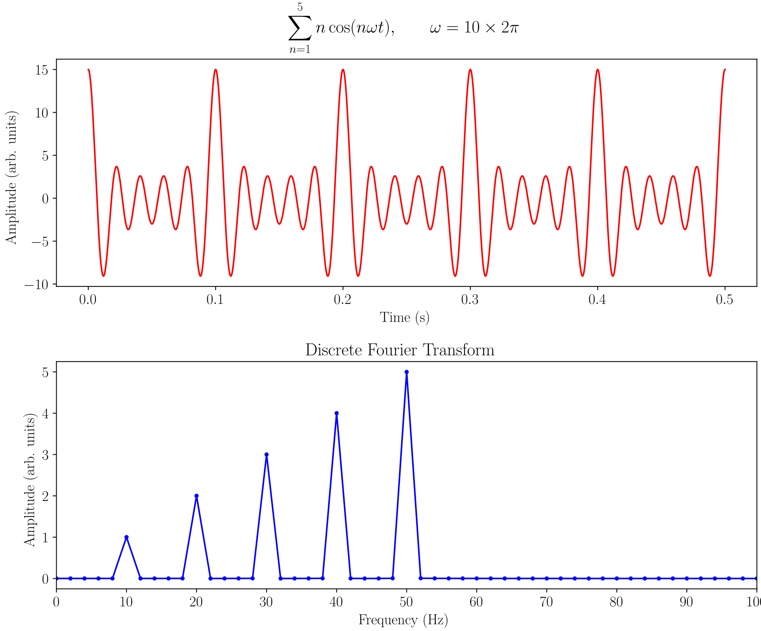
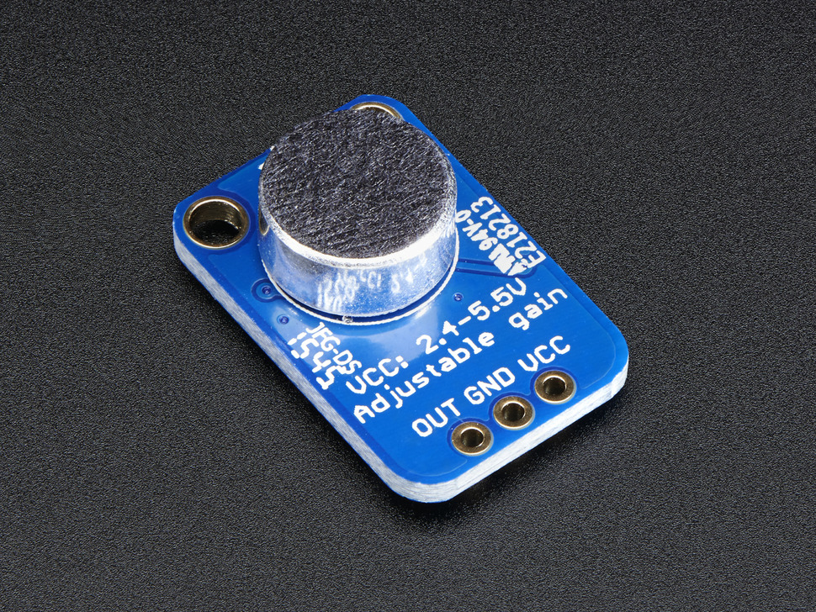
2.5 Acoustic Sensor
FFT (Fast Fourier Transform)
: an algorithm that computes the discrete Fourier Transform of a sequence, or its inverse.
Original domain -> Frequency domain
FFT
(Fast Fourier Transform)
Spectrum
Audio Signal
Time
Frequency
[max4466]
Frequency

Slide 19

2.1 ~ 2.5 Demo Video
Esp32 — the things stack cloud server — MQTT Broker

Slide 20
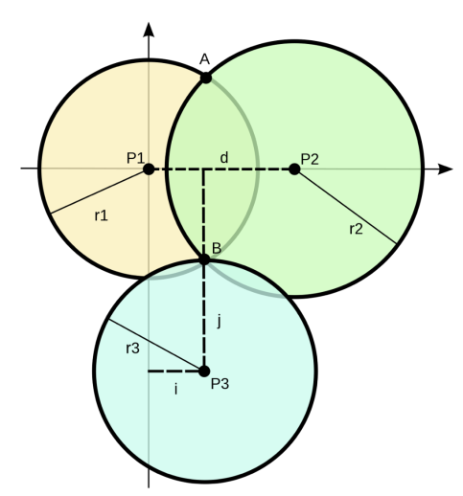
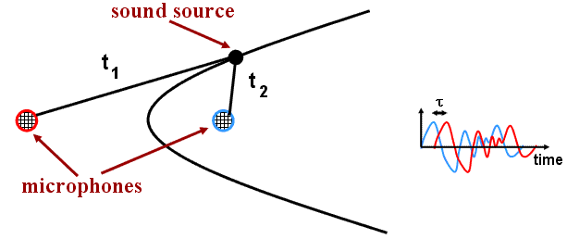
2.6 Acoustic Localization
[Trilateration]
[Triangulation] - hyperbola
sound source
r1 N
Amplifier
The process of acoustic localization using forming triangles to the point from known points
Three hyperbola ⇒ the source of the sound
r1, r2, r3: distance between the source of the sound and three acoustic sensors
N: the first time when the sound came in

Slide 21
Problem
03
Problem

Slide 22
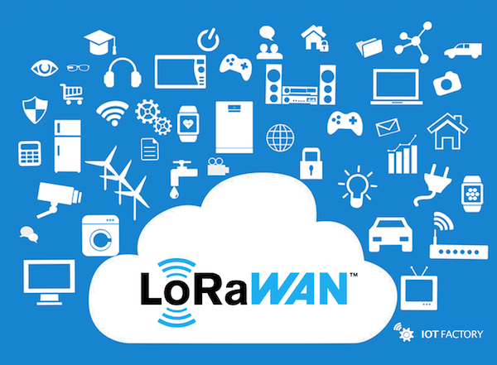
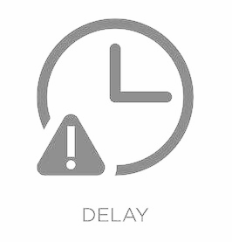
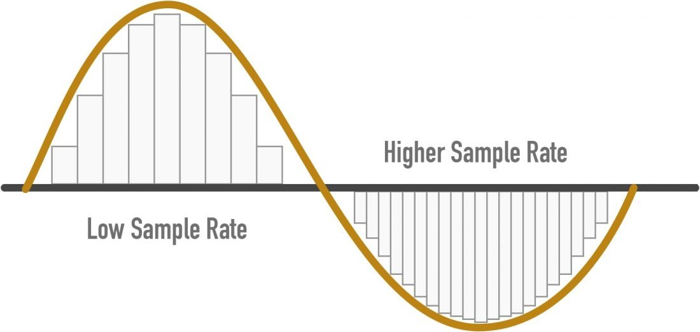

3. Problem
Low Power
Low Bit Rate Networking Protocols
??

Slide 23
Weekly Plan
04
Weekly Plan

Slide 24
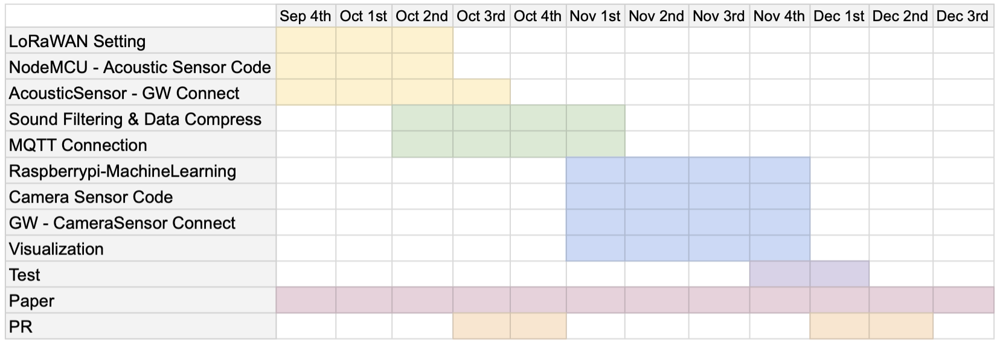
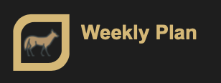
4. Weekly Plan

Slide 25
[References]
[1] United State Department of Agriculture (USDA)., "Death Loss in U.S. Cattle and Calves Due to Predator and Nonpredator Causes, 2015," in USDA, Dec. 2017. [Online]. Available: https://www.aphis.usda.gov/aphis/ourfocus/animalhealth/monitoring-and-surveillance/nahms/nahms-studies/nahms-studies-table?cat=general
[2] AWS, "What is LoRaWAN?", Accessed: Oct, 19, 2022. [Online]. Available: https://docs.aws.amazon.com/iot/latest/developerguide/connect-iot-lorawan-what-is-lorawan.html
[3] Brian. O. "Finding Location with Time of Arrival and Time Difference of Arrival Techniques" ECE Senior Capstone Project, 2017. [Online]. Available: https://sites.tufts.edu/eeseniordesignhandbook/files/2017/05/FireBrick_OKeefe_F1.pdf
[4] ESPRESSIF, “ESP32 Series of Modules”, Accessed: Oct, 19, 2022. [Online]. Available: https://www.espressif.com/en/products/modules/esp32
[5] D. Gusland. “Arduino Sound Localization” Github.com, Jan 6, 2019 [Online]. Available: https://github.com/danielgusland/Arduino-sound-localization#
[6] KanyonKris. “Setting up Basic Station protocol on RAK7240 and RAK7249 industrial gateways” The Things Network. Apr, 21, 2021. [Online]. Available: https://www.thethingsnetwork.org/forum/t/setting-up-basic-station-protocol-on-rak7240-and-rak7249-industrial-gateways/37011/9
[7] [14] abhilash_patel. “EasyFFT: Fast Fourier Transform (FFT) for Arduino”. Arduino Project Hub. Jul, 12, 2020 [Online]. Available: https://create.arduino.cc/projecthub/abhilashpatel121/easyfft-fast-fourier-transform-fft-for-arduino-9d2677’

Slide 26
Q&A

Slide 27
Thank you

